Slide 1
ACADEMIC PRESENTATION
Multimedia
Data Mining
Extracting Knowledge from Images, Audio, Video & Text
Department of Computer Science | Data Mining & Knowledge Discovery

Slide 2
AGENDA
01
Introduction to Multimedia Data Mining
Topics
Covered
02
Types of Multimedia Data
03
Key Techniques & Algorithms
04
Applications & Use Cases
05
Challenges & Future Trends

Slide 3
01
What is Multimedia Data Mining?
Multimedia Data Mining is the process of discovering interesting patterns and knowledge from large collections of multimedia data — including text, images, audio, and video — using computational techniques from data mining, machine learning, and pattern recognition.
80%
5×
2.5EB
of all data generated globally is multimedia
faster insights vs. manual analysis
of data created every single day
Bridging the gap between raw media and actionable knowledge — powering modern AI, search, healthcare, and security.

Slide 4
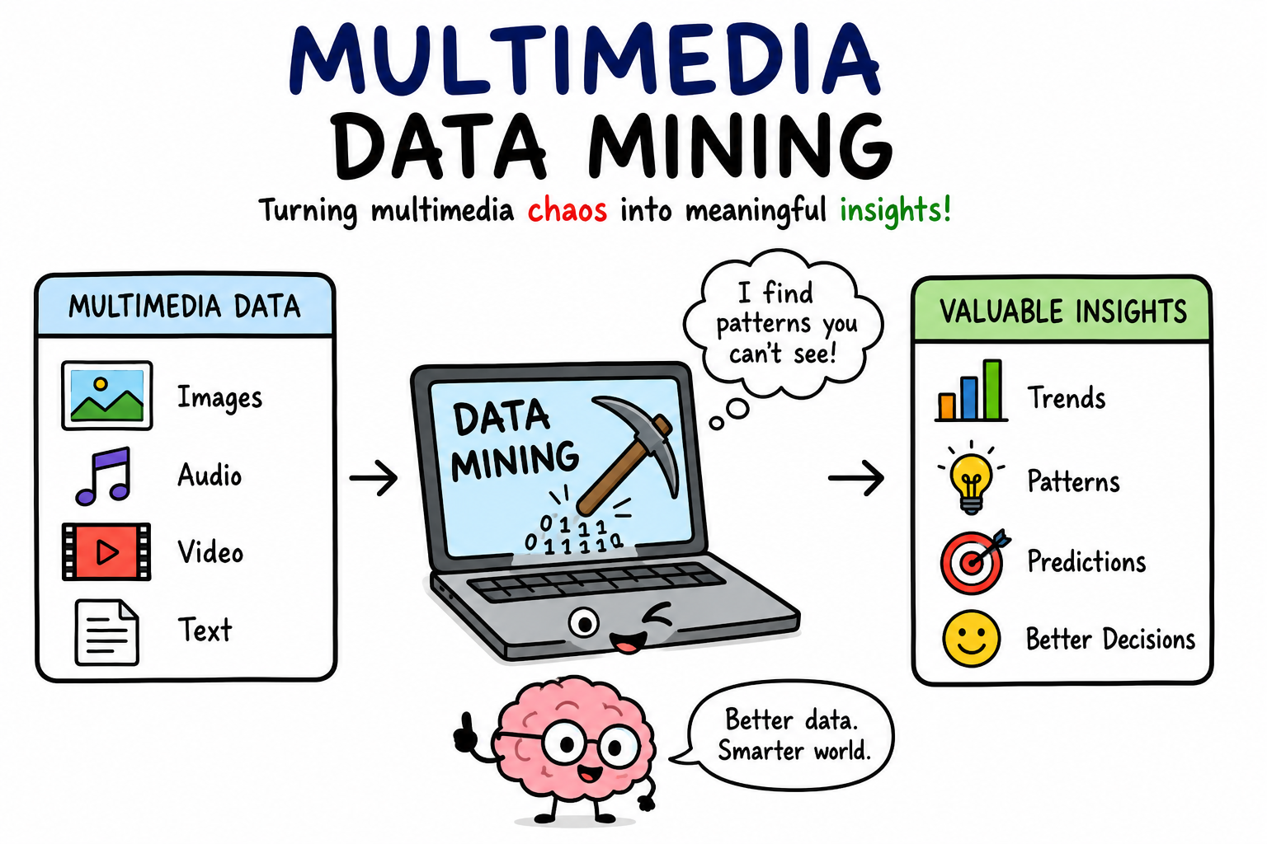

Slide 5

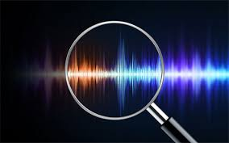
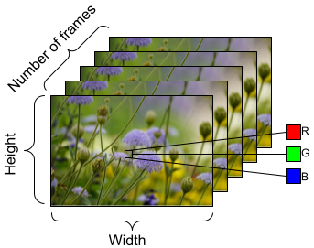
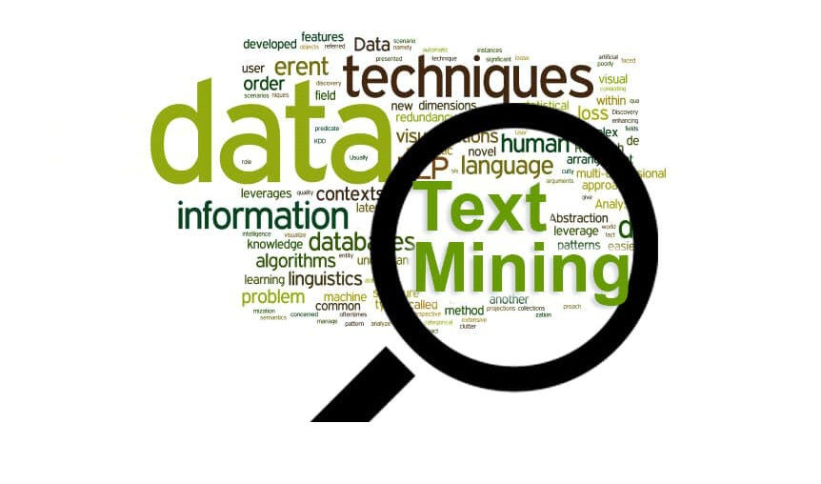
02
Types of Multimedia Data
🖼 Image Data
🎵 Audio Data
• JPEG, PNG, BMP formats
• Spatial pixel features
• Object & scene recognition
• Medical imaging (MRI, X-ray)
• Speech & music streams
• Temporal waveforms
• Spectrogram analysis
• Emotion & speaker detection
🎬 Video Data
📝 Text Data
• Sequence of image frames
• Motion detection features
• Scene segmentation
• Surveillance & analytics
• Documents, captions, OCR
• Semantic feature vectors
• Sentiment analysis
• Captions in media files

Slide 6
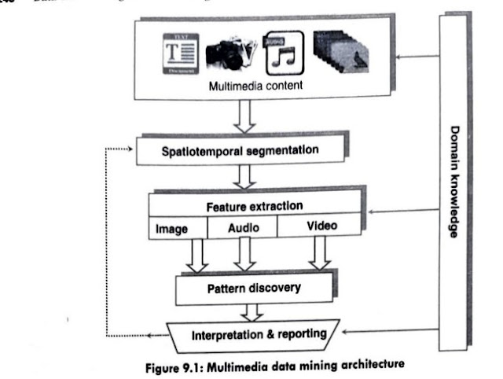

Slide 7
03
Key Techniques & Algorithms
Feature Extraction
Clustering
Classification
SIFT, MFCC, CNN embeddings to capture essential data characteristics
K-Means, DBSCAN, hierarchical methods to group similar multimedia items
SVM, Random Forest, Deep Neural Networks for labeling media objects
Similarity Search
Deep Learning
Association Mining
Content-Based Image Retrieval (CBIR), cosine similarity, LSH indexing
CNNs for images, RNNs/Transformers for sequences, GANs for synthesis
Finding co-occurrence patterns across modalities (text+image+audio)

Slide 8
04
Applications & Use Cases
🏥
Healthcare
🔒
Security
🔍
Search Engines
Medical image analysis (MRI/CT/X-ray), disease detection, pathology slide classification
Facial recognition, fingerprint matching, video surveillance, anomaly detection
Reverse image search, video content indexing, audio fingerprinting (Shazam)
🛒
E-Commerce
🎬
Entertainment
🌍
Geospatial
Visual product search, recommendation systems, counterfeit image detection
Content recommendation, automatic tagging, highlight reel generation
Satellite image classification, disaster mapping, urban change detection

Slide 9
05
Challenges & Future Trends
⚠ Current Challenges
🚀 Future Trends
→ High dimensionality of multimedia features
→ Multimodal Large Language Models (GPT-4V, Gemini)
→ Semantic gap between low-level features & high-level meaning
→ Self-supervised & zero-shot learning
→ Massive storage and computational costs
→ Real-time video understanding at scale
→ Privacy concerns in facial & biometric data
→ Explainable AI for multimedia mining
→ Lack of labeled training datasets
→ Federated learning for privacy-preserving mining
→ Cross-modal fusion complexity
→ 3D & AR/VR data mining

Slide 10
KEY TAKEAWAYS
Summary
🔍
Multimedia data mining unlocks insights hidden in images, audio, video, and text
🤖
Deep learning & multimodal AI are revolutionizing the field rapidly
🌐
Applications span healthcare, security, search, retail, and beyond
⚡
Key challenges include the semantic gap, computational cost, and privacy
🔮
The future is multimodal — fusing all data types for richer intelligence

